Slide 1

Deepdive Unit Testing in .NET

Slide 2
Agenda Day 1
Check-in
Unit testing 101
.NET Unit Test Frameworks
Test Driven Development
Exceptions
Testable code
Mocking dependencies
System.IO
Async
Checkout

Slide 3
Format
Slides
Demos
Hands-On-Labs
TDD katas
Pair programming
Ask for help
Central review afterwards

Slide 4

Unit Testing 101

Slide 5
Unit test definition
A piece of code that invokes a unit of work in the system and then checks a single assumption about the behavior of that unit of work
Test code verifying application code

Slide 6
Impact of unit testing
Functional design
Requires (re)formulating functionality in testable way
Technical design
Simpler class hierarchies
Coding
Less code
Bugs and debugging
Exposes flaws and holes in design
Uncovers invalid and implicit assumptions
Component oriented
Evolves through refactoring
Smaller functions
Less conditional code
A lot more testing code
Bugs are more easily reproduced
Debugging becomes simpler
Solving bugs requires mostly local code changes

Slide 7
Unit testing in the Software Development Lifecycle
Coding
Unit Testing
Debugging
Code Analysis
Source Control
Continuous Integration
Continous Deployment
Shift left

Slide 8
Testing Pyramid
10%
Unit tests
Automated GUI tests
Automated API tests Automated Integration tests Automated component tests
Selenium
Protractor
Coded UI
20%
Longer Execution
Time
Increased Stability
FitNess
SpecFlow
Cucumber
70%
MSTest
xUnit
Nunit

Slide 9
A good unit test is
Independent
No shared state
No order between tests
No external dependencies
Consistent
Fast to execute
Readable
Maintainable
Trustworthy

Slide 10
Naming convention
Use a clear naming convention for unit tests such as [UnitOfWork]_[Scenario]_[ExpectedBehaviour] Examples RegisterUser_WithValidUser_ShouldReturnUserId RegisterUser_WithInvalidUser_ShouldThrowInvalidUserException

Slide 11
BDD style naming convention
Alternative Behaviour Driven Development style [GivenPreconditions_WhenStateUnderTest_ThenExpectedBehavior] Examples GivenAValidUser_WhenUserIsRegistered_ThenReturnUserIdShouldBeReturned GivenAnInvalidUser_WhenUserIsRegistered_ ThenAnInvalidUserExceptionShouldBeThrown

Slide 12
Unit Test Responsibility
Identify unit of work
Prepare system under test
Execute unit of work
Verify behavior or outcome

Slide 13
Unit test structure: AAA
// Arrange var registrationService = new RegistrationService(); var newUser = new User(“Grace Hopper”, “grace@hopper.org”) // Act var result = registrationService.RegisterUser(newUser); // Assert Assert.NotNull(result, “It is expected that the result is the registered user.”);

Slide 14

.NET Unit Test Frameworks

Slide 15
.NET Unit Test Frameworks
Provides an API to structure tests
Assert outcomes
Examples:
MSTest
NUnit
xUnit

Slide 16
Unit Test Framework Attributes
 | MSTest | NUnit | xUnit
Identify test class | [TestClass] | [TestFixture] | -
Identify test method | [TestMethod] | [Test] | [Fact]
Parameterized test method | [DataTestMethod] | [TestCase] | [Theory]
Run before every test in a class | [TestInitialize] | [SetUp] | -
Run after every test in a class | [TestCleanup] | [TearDown] | -
Run once before any tests are run in a class | [ClassInitialize] | [OneTimeSetUp] | -
Run once after all tests are run in a class | [ClassCleanUp] | [OneTimeTearDown] | -

Slide 17
Frameworks & Libraries
Unit testing
MSTest
Nunit
Mocking
Moq
Nmock
Arrange
AutoFixture
Assert
FluentAssertions
Shouldy
xUnit
FakeItEasy
NSubstitute

Slide 18
Assertions
NUnit // Don’t do this Assert.IsTrue(result == 2); // Slightly better, but not the best to read Assert.AreEqual(2, result); // Very expressive and fluent! Assert.That(result, Is.EqualTo(2), “Result is expected to be equal to 2, please check the nameof(Calculator) class.”);

Slide 19
Assertions
FluentAssertions result.Should().NotBeNull() result.Should().StartWith(“A”).And.Contain(“BC”) .And.HaveLength(5); collection.Should().NotBeNullOrEmpty();

Slide 20
DEMO
Unit testing with xUnit
Assertions

Slide 21

Test Driven Development

Slide 22
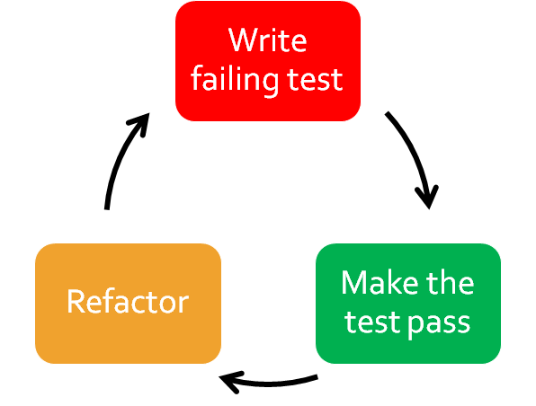
Test Driven Development

Slide 23


Slide 24
TDD
Write the minimum amount of code in order to pass the test.
Having a small unit of work makes the debugging easier
Makes test code easier to read & understand

Slide 25
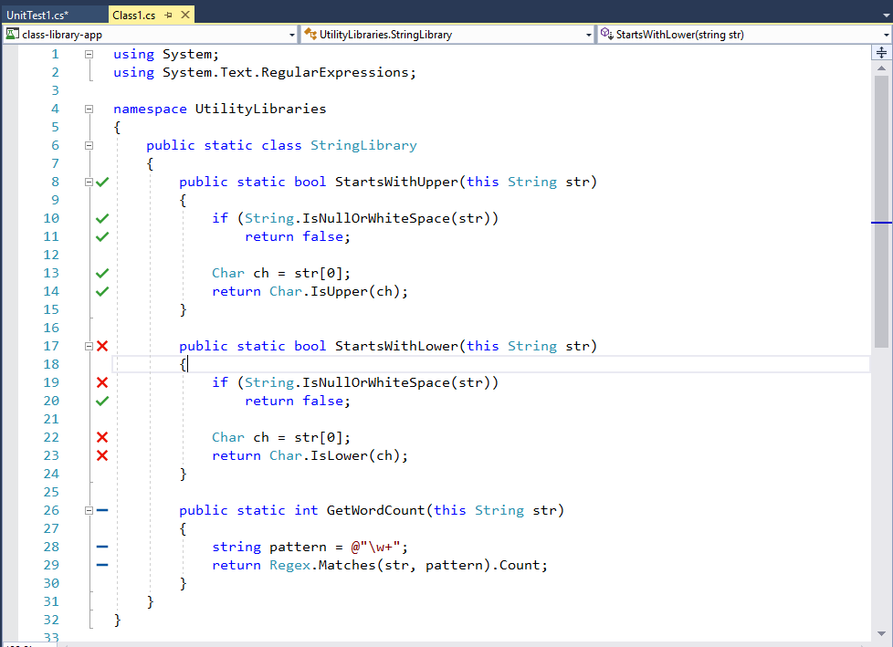
Live Unit Testing in VS2017 Enterprise

Slide 26
TDD kata
“A kata is a form of deliberate practice, with its roots in the martial arts world. It describes a choreographed pattern of movements used to train yourself to the level of muscle memory.
In the world of programming, katas are small coding exercises that a programmer completes on a daily basis. ”

Slide 27
Hands-on-Labs Solution & Docs
Clone repo: https://github.com/XpiritBV/UnitTesting
Read tdd_katas/tdd_kata_start.md
Open the Xpirit.UnittestingWorkshop.sln

Slide 28
Hands-on-Labs
Perform TDD Kata 1– Player (15 min timebox)
Pair programming
Ask for help
Central review afterwards

Slide 29
Hands-on-Labs
Perform TDD Kata 2 – Moving (20 min timebox)
Pair programming
Ask for help
Central review afterwards

Slide 30
Hands-on-Labs
Perform TDD Kata 3 – Winning (20 min timebox)
Pair programming
Ask for help
Central review afterwards

Slide 31

Testable Code

Slide 32
SOLID principles
S - Single-responsibility principle
O - Open-closed principle
L - Liskov substitution principle
I - Interface segregation principle
D - Dependency Inversion Principle

Slide 33
Single responsibility principle
“A class should have one and only one reason to change, meaning that a class should have only one job.”

Slide 34
Open-closed principle
“Objects or entities should be open for extension, but closed for modification.”

Slide 35
Liskov substitution principle
“Objects in a program should be replaceable with instances of their subtypes without altering the correctness of that program.”

Slide 36
Interface segregation principle
“Many client-specific interfaces are better than one general-purpose interface.”

Slide 37
Dependency inversion principle
“One should "depend upon abstractions, not concretions.”

Slide 38
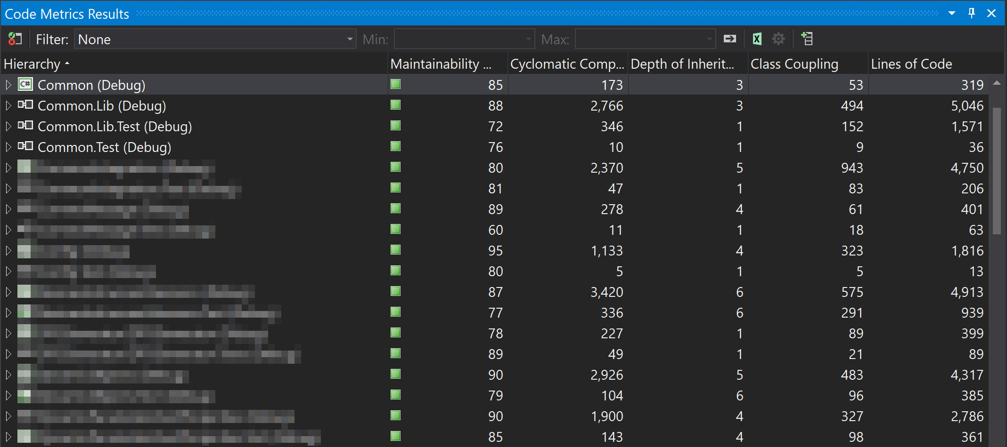
Analyze > Calculate Code Metrics

Slide 39
Seams
Seams are places in the code where behavior can be changed to allow unit testing
Do use dependency injection using interfaces
Do use virtual methods or properties
Don’t use static classes

Slide 40
Unit Isolation
Unit tests do not use actual implementation of dependencies
Databases
Web services
File system
Replace dependencies with fake objects
Choose size of your unit:
Unit isolation testing
Unit integration testing

Slide 41
Dependency Inversion
High-level modules should not depend on low-level modules. Both should depend on abstractions.
Abstractions should not depend on details. Details should depend on abstractions
Class A
Interface A
Class B

Slide 42
Dependency Injection
Make internal dependencies accessible to outside world
Convenient in a lot of situations, e.g. changes, testing
Be explicit about dependencies
Three common ways to inject a dependency
Constructor
Property
Method call

Slide 43
Constructor Injection
public class Game
{
private IHighScoreService highScoreService; public Game(IHighScoreService highScoreService) { this.highScoreService = highScoreService; }
public void Play() { highScoreService.Start(); … }
}

Slide 44
Constructor Injection with default
public class Game
{
private IHighScoreService highScoreService; public Game(IHighScoreService highScoreService = null) { this.highScoreService = highScoreService ?? new HighScoreService(); }
public void Play() { highScoreService.Start(); … }
}

Slide 45
Property Injection
public class Game
{
public IHighScoreService HighScoreService { get; set; }
public void Play() { HighScoreService.Start(); … }
}

Slide 46
Property Injection with default
public class Game
{
private IHighScoreService highScoreService; public IHighScoreService HighScoreService { get => highScoreService ?? new HighScoreService(); set => highScoreService = value; }
public void Play() { HighScoreService.Start(); … }
}

Slide 47

Mocking dependencies

Slide 48
Mocking Frameworks
A mocking framework helps to isolate the behavior of the system under test . It can replace dependencies with mocked objects which can simulate the behavior of the dependencies.
Examples:
Moq
NMock
Nsubstitute
FakeItEasy

Slide 49
DEMO: Mocking framework

Slide 50
State & Interaction based tests
 | State-based | Interaction-based
When to use | Care about state of an object. | Care about the behavior of an object.
What is asserted | The system under test itself. | A (mocked) object the system under test is dependent on.
Examples | Assert a property or method result has a certain value. | Verify that a method has been called. Verify the arguments of a method.

Slide 51
Hands-on-Labs
Perform TDD Kata 5 - Logging (15 min timebox)
Pair programming
Ask for help
Central review afterwards

Slide 52

Testing Exceptions

Slide 53
DEMO
Testing exceptions

Slide 54
Unit Testing Exceptions
xUnit
// Act Action action = () => new Game(null);
// Assert Assert.Throws<ArgumentNullException>(action)
// Act & Assert
Assert.Throws<ArgumentNullException>(
() => new Game(highscoreService));

Slide 55
Unit Testing Exceptions
FluentAssertions
// Act Action action = () => new Game(null);
// Assert action.ShouldThrow<ArgumentNullException>();

Slide 56
Hands-on-Labs
Perform TDD Kata 4 – Boundaries (20 min timebox)
Pair programming
Ask for help
Central review afterwards

Slide 57

Dealing With System.IO

Slide 58
Dealing with System.IO
Don’t depend directly on System.IO implementation!
Directory.GetFiles(…)
File.Exist(…)
Use a wrapper such as WrapThat.System and use IDirectory and IFile interfaces in your code.

Slide 59
Hands-on-Labs
Perform TDD Kata 6 – Using game state (20 min timebox)
Pair programming
Ask for help
Central review afterwards

Slide 60
Hands-on-Labs
Perform TDD Kata 7 – Saving game state (20 min timebox)
Pair programming
Ask for help
Central review afterwards

Slide 61

Testing Async Code

Slide 62
DEMO: Testing async code

Slide 63
Hands-on-Labs
Perform TDD Kata 8 – Async Saving & loading (20 min timebox)
Pair programming
Ask for help
Central review afterwards

Slide 64
Check out
What did you like best?
What could be improved?
Which topics should we cover next lesson?

Slide 65


